Slide 1
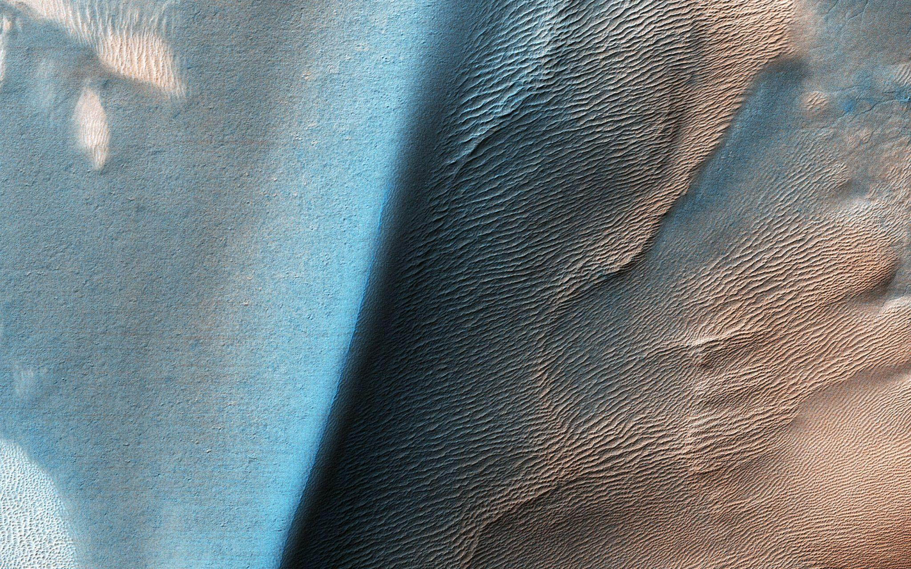
Landmark Identification on Mars
Image Science and Analysis Group

Slide 2
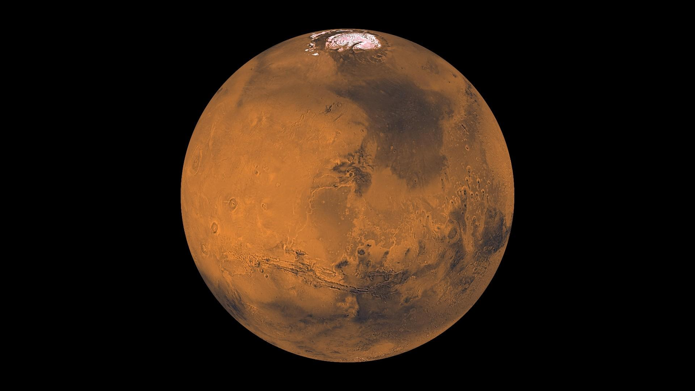




github.com/alvaromendizabal
linkedin.com/in/alvaro-mendizabal/
alv.mendizabal@gmail.com
Alvaro Mendizabal

Slide 3
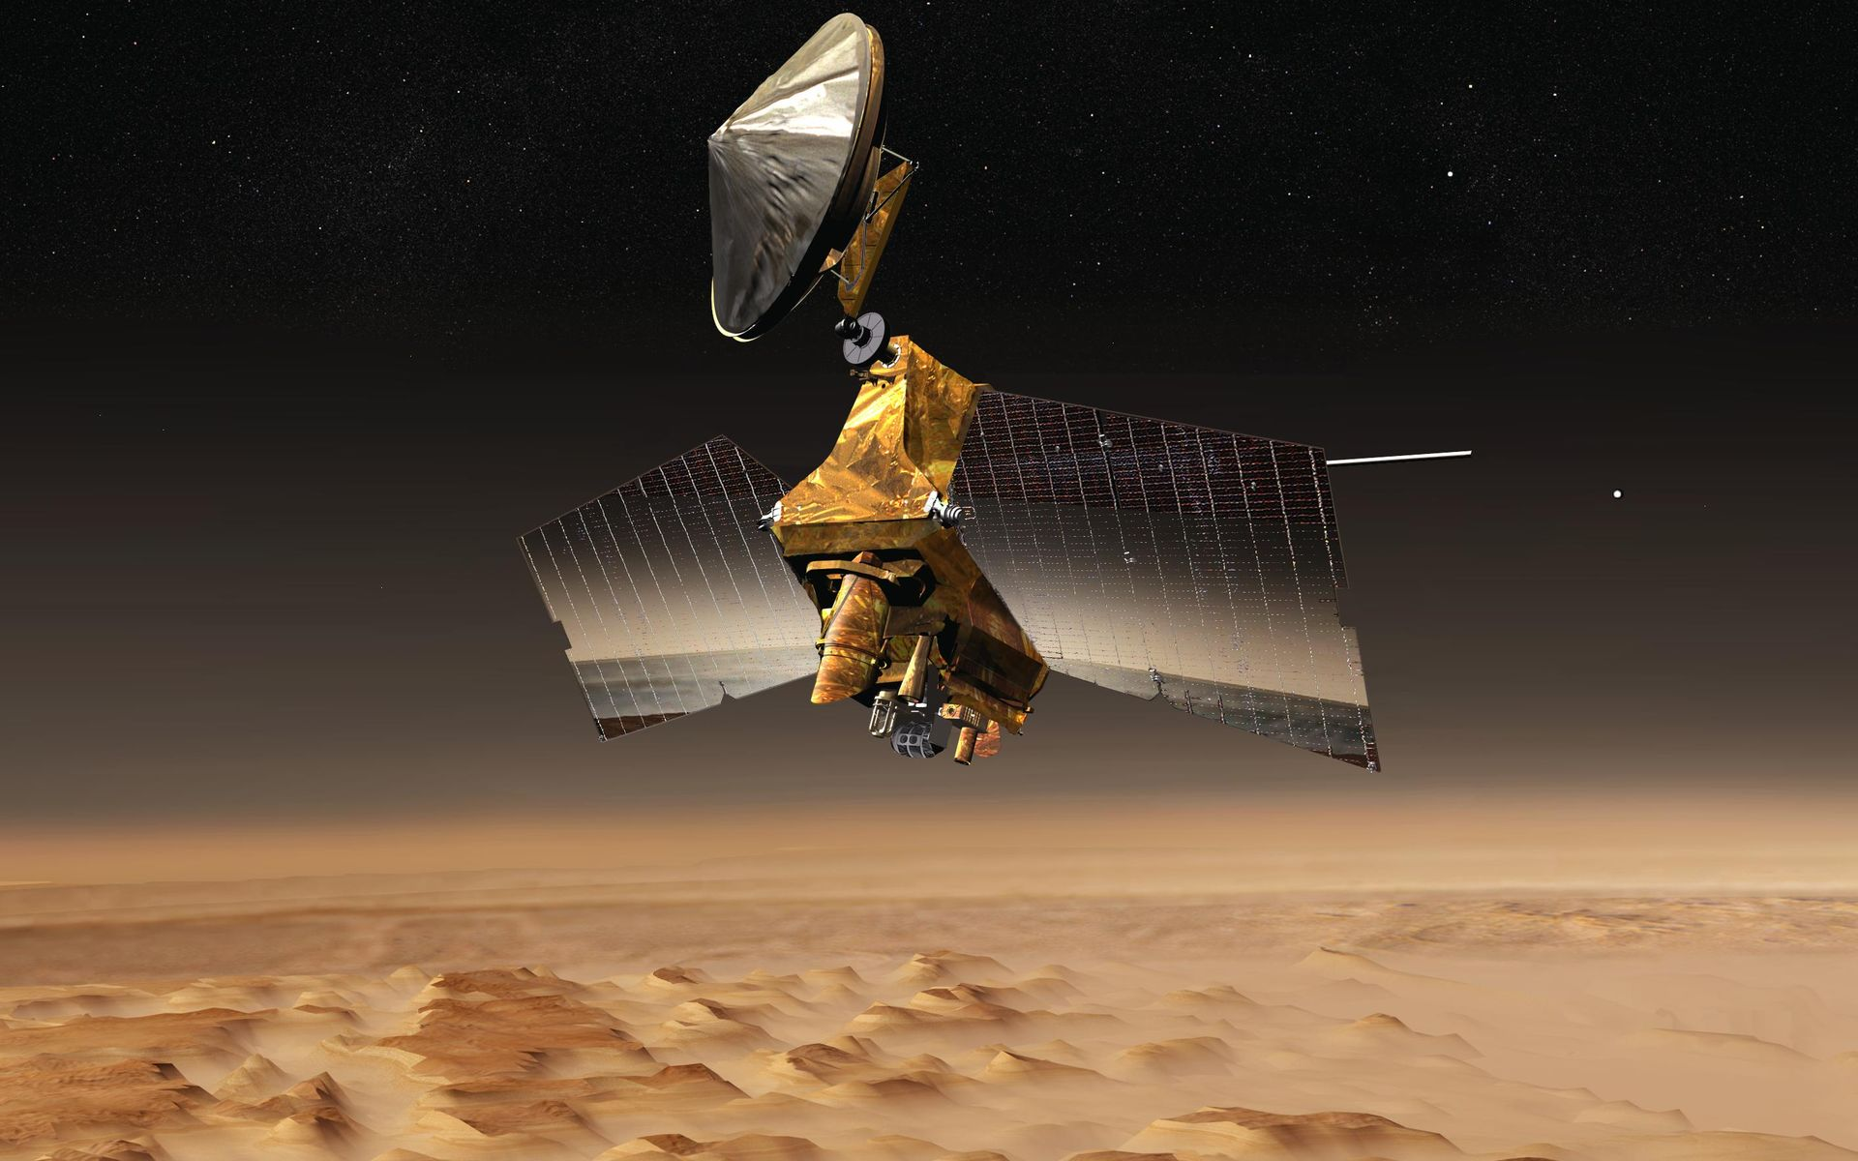
Data
64,947 Images
HiRISE on Mars Reconnaissance Orbiter
8 Classes

Slide 4
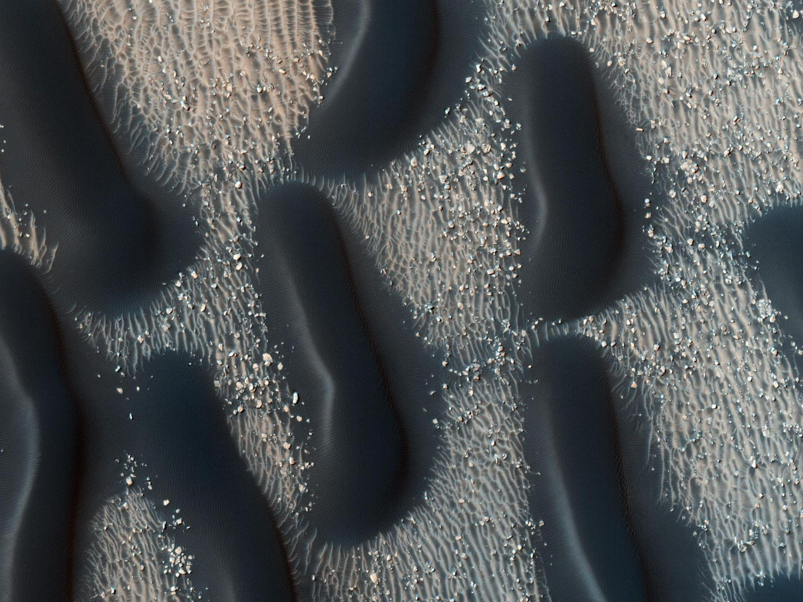
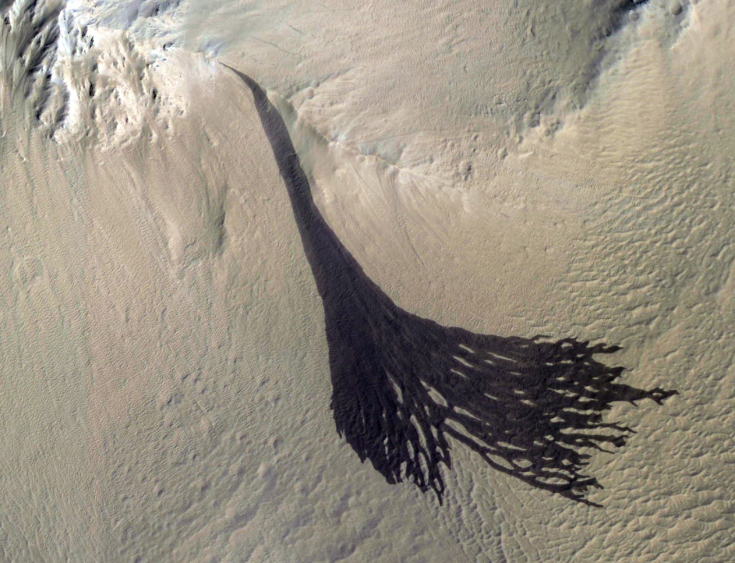
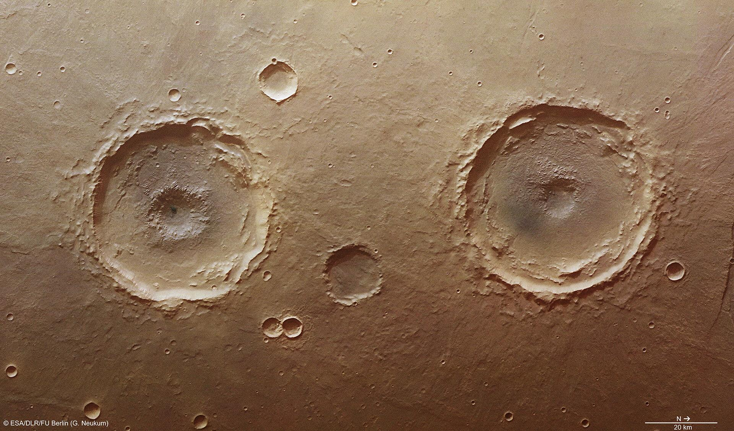
dark dune
bright dune
slope streak
crater

Slide 5
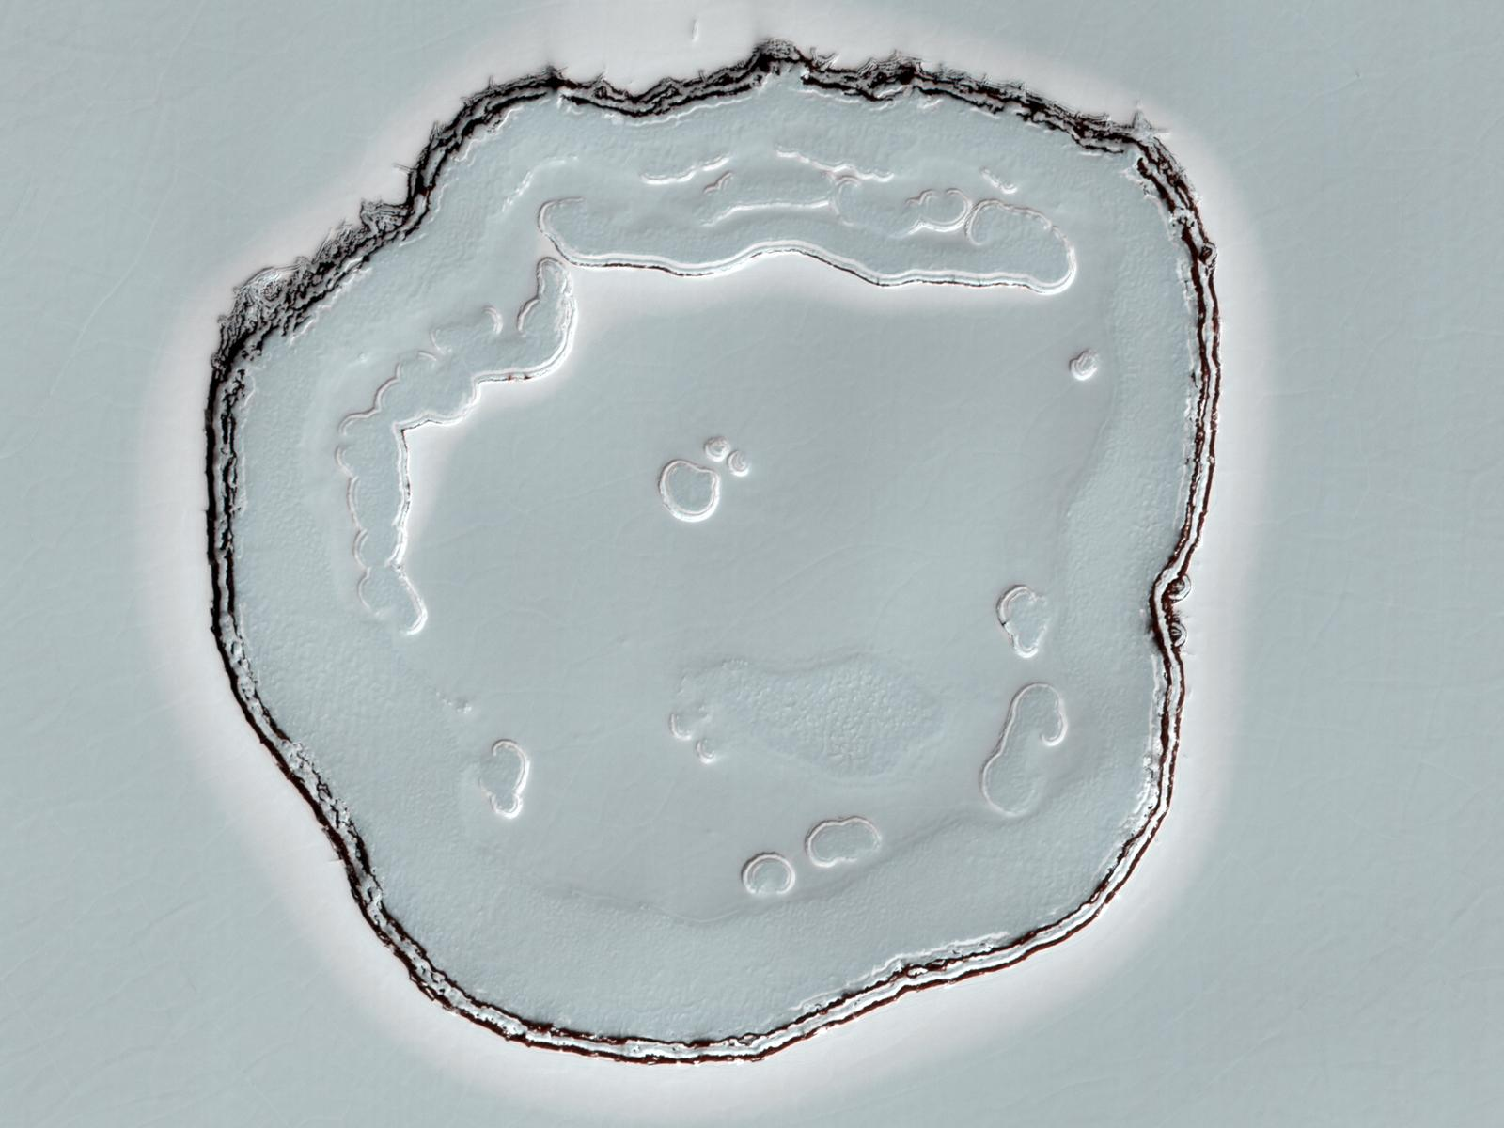
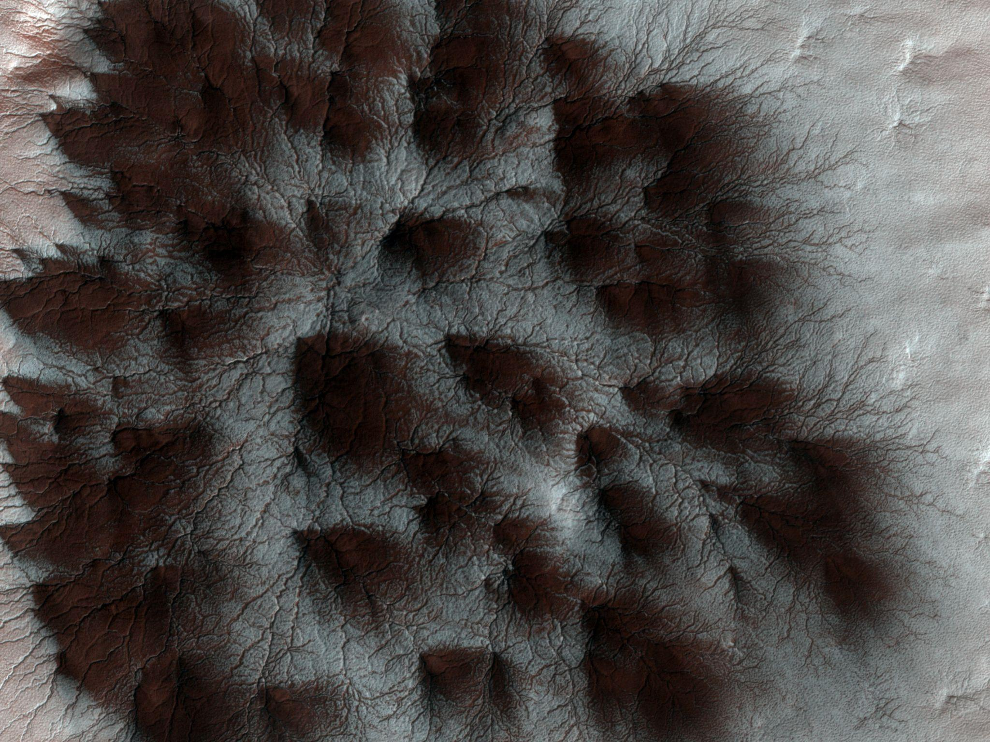
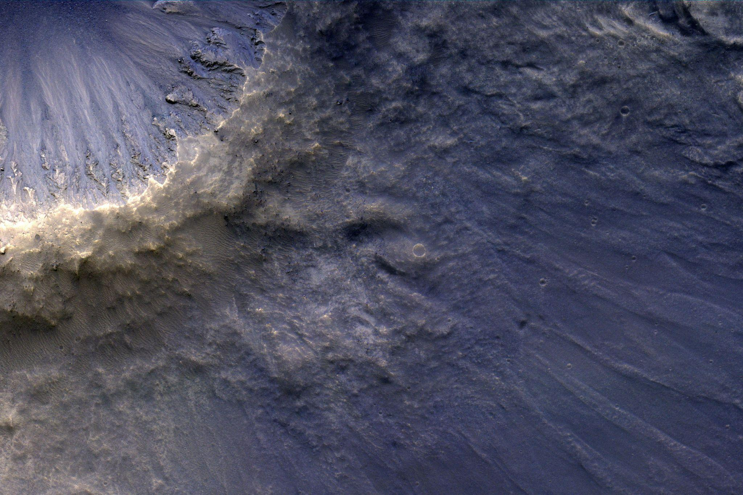
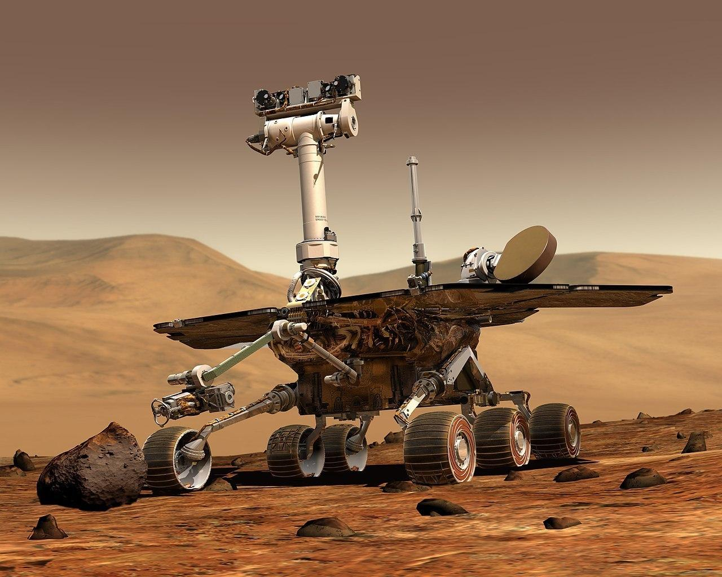
swiss cheese
spiders
impact ejecta
other

Slide 6
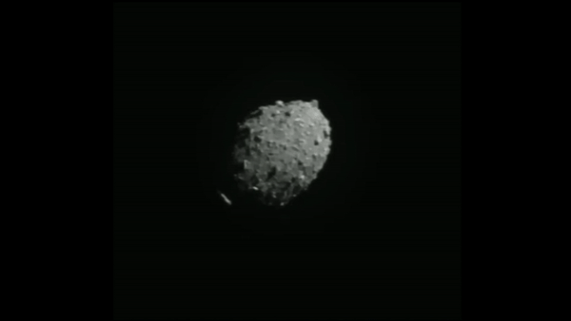

Slide 7
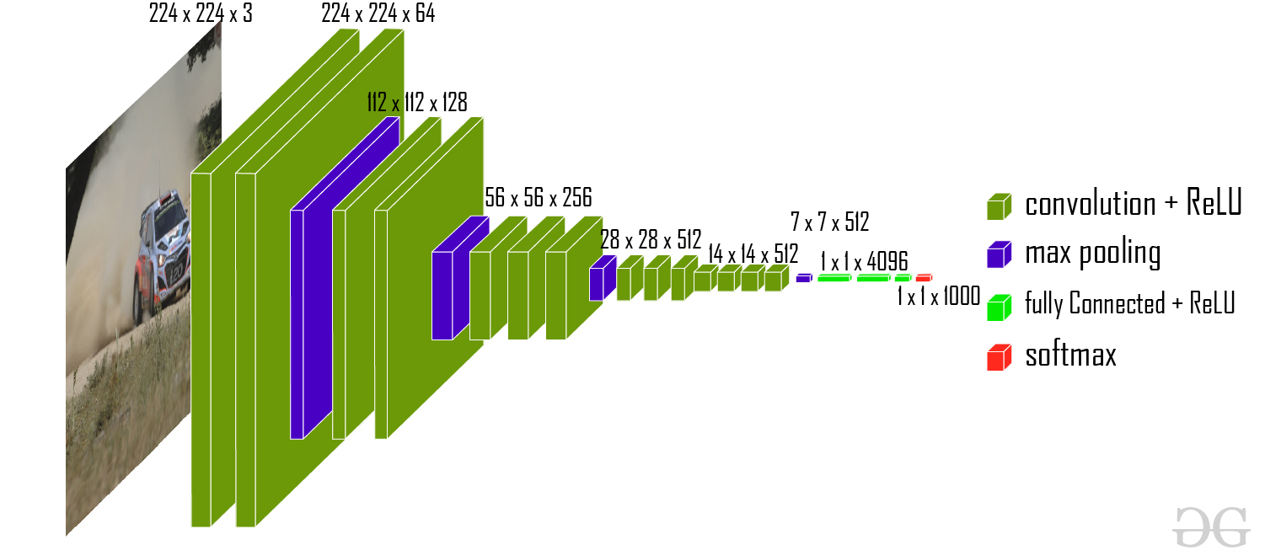

Slide 8
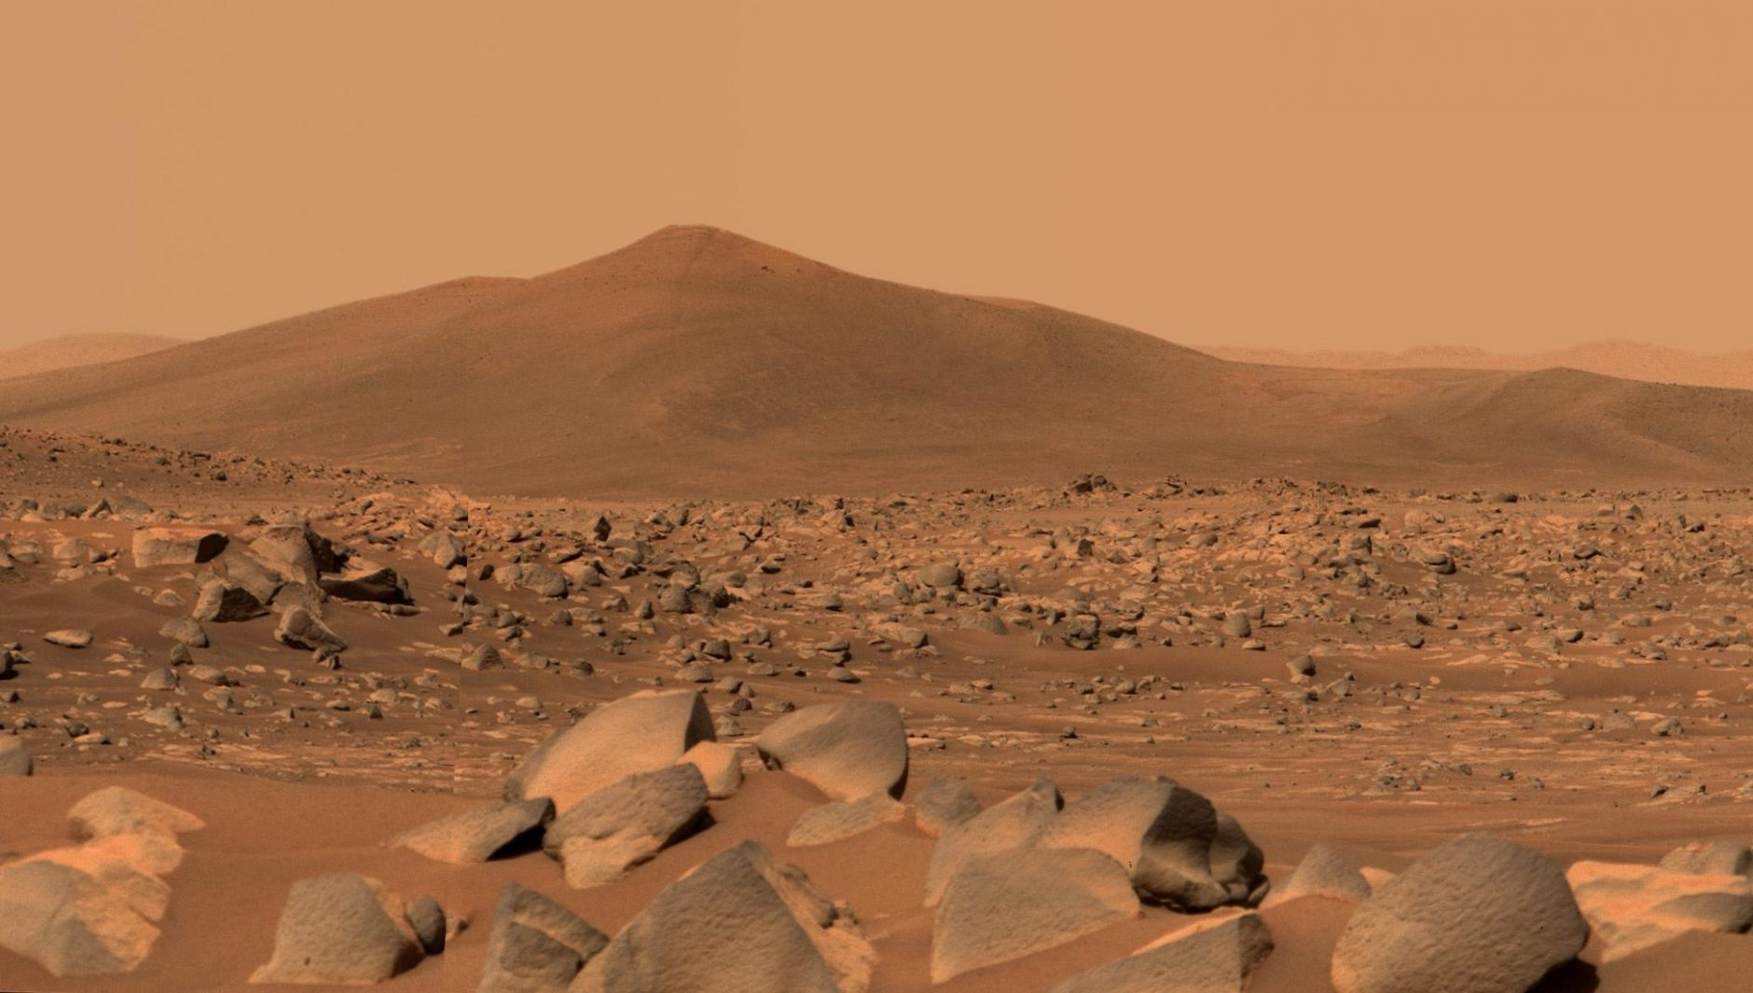
91.4% Accuracy

Slide 9
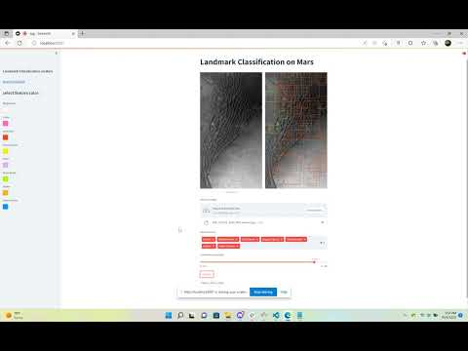

Slide 10
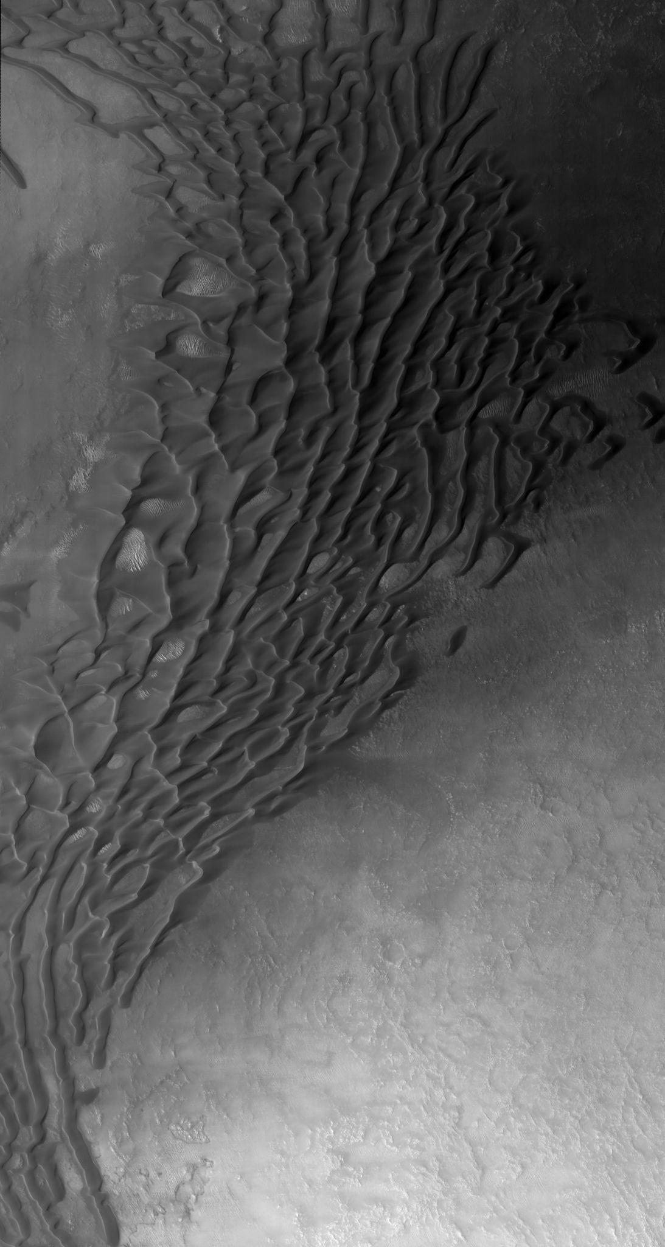
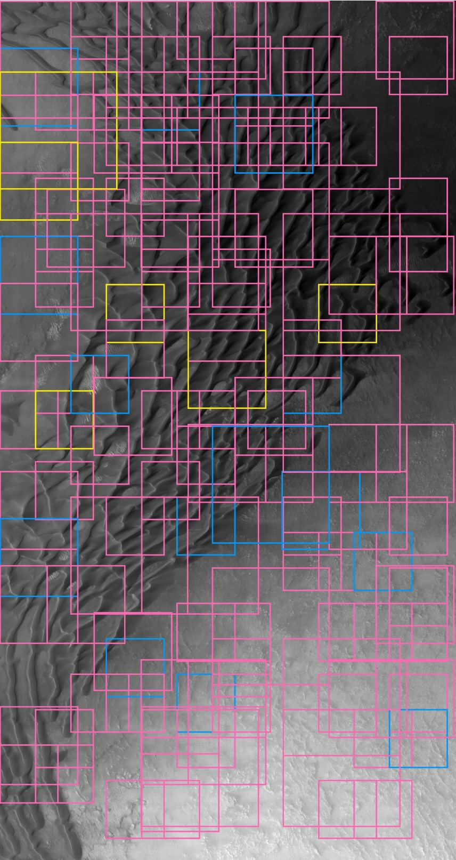
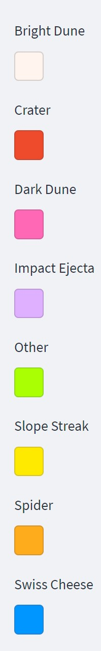

Slide 11
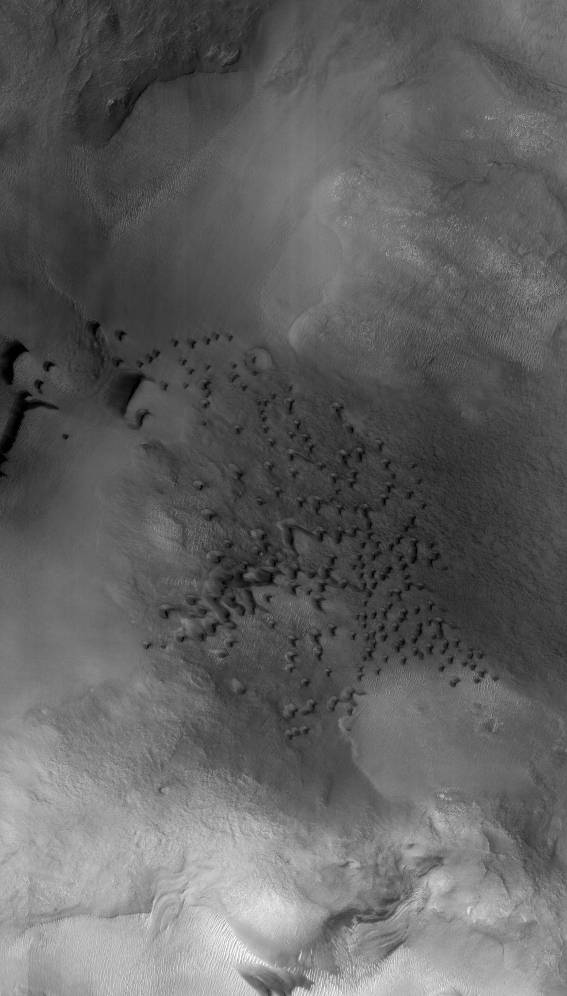
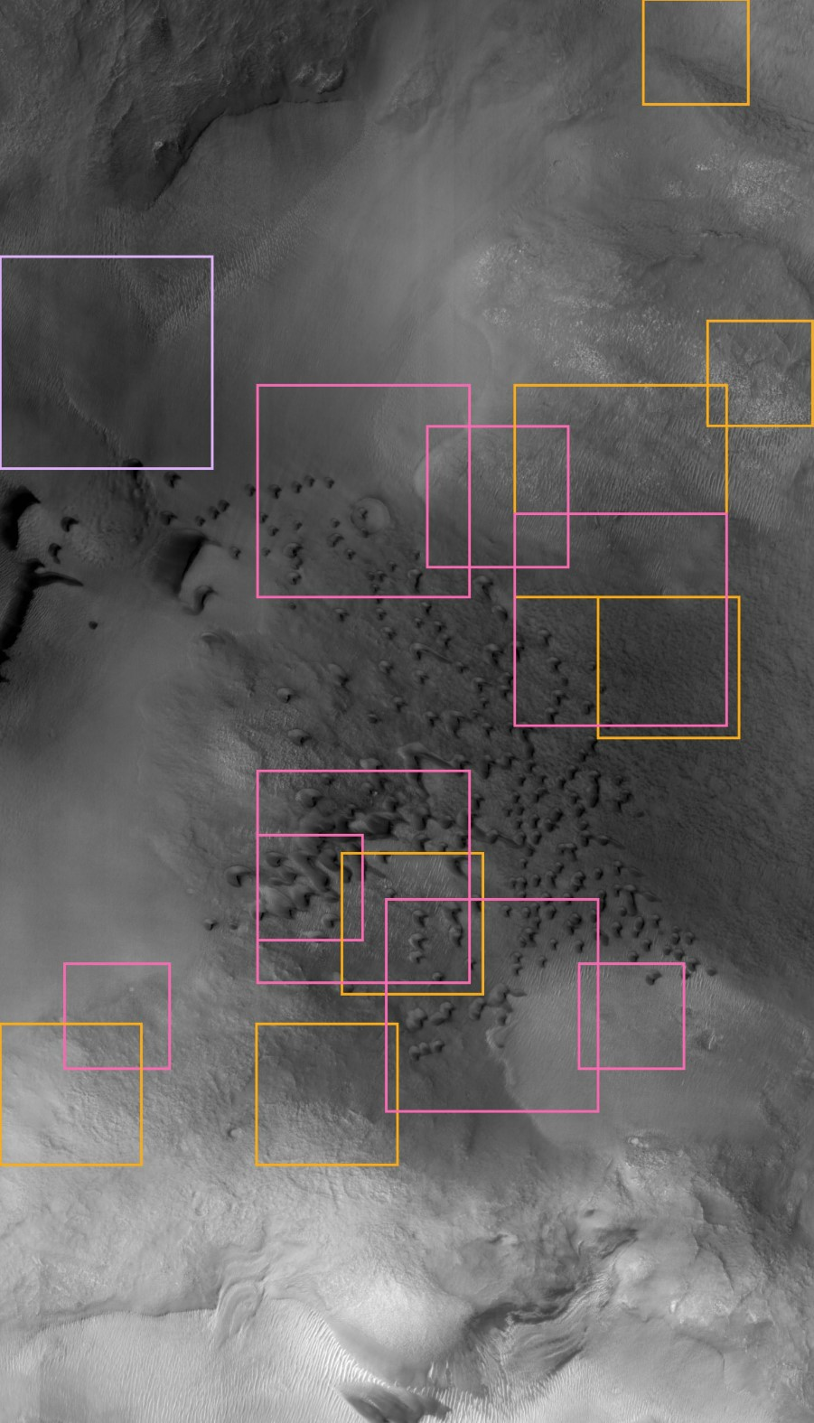

Slide 13
github.com/alvaromendizabal
linkedin.com/in/alvaro-mendizabal/
alv.mendizabal@gmail.com

